Slide 1

The Dog
Anthony and Christopher

Slide 2
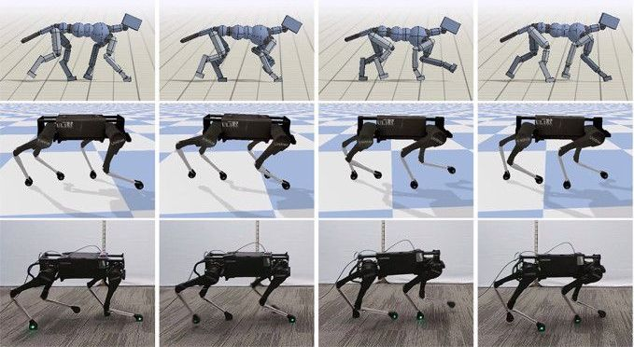
Choosing a Leg Design
Major Requirements for Leg Design:
Dog must support itself while two legs are off the ground
Legs will work with 3 DOF
Dog must be stable while in motion

Slide 3
Supporting Weight
The dog’s movement will be a trot gait, meaning that at any given moment, up to two legs will be off the ground
Therefore, the weight of the dog must be supported by two legs
Legs in air or on ground will be diagonal of each other
The legs must be able to hold a maximum weight of 25lbs while idle as well as in movement

Slide 4
3 DOF
Two degrees are needed to allow for control of vertical and horizontal movement
A third degree of freedom is necessary to allow for rotational movement about the frame of the robot to allow for turning about the center of the body

Slide 5
Stability
A metal rods will act as a “spine” of sorts down the center of the body
The rods should improve stability by preventing slight angular and position displacements caused by the moments that the motors create
In conjunction, rubber stoppers/padding can act as a dampener to also decrease vibrations in direction of leg movement

Slide 6
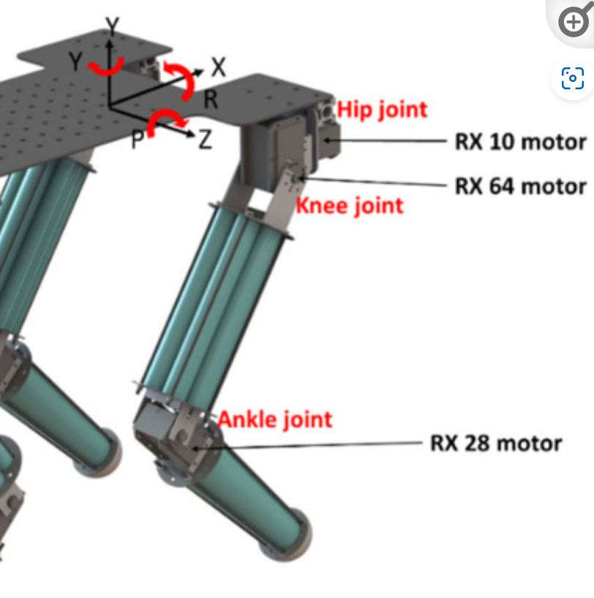
Choosing a Leg Design
Option 1: 3 Servo Config.

Slide 7
3 Servo
The dog’s leg will use three servo motors
One at the “knee”
Two at the “shoulder”
Backdrive can be prevented with wormgears
Torque increased with gear ratio

Slide 8
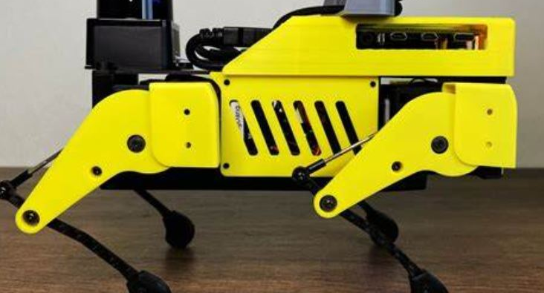
Choosing a Leg Design
Option 2: Mini Pupper

Slide 9
Mini Pupper
The dog’s leg will use three servo motors
All three at the shoulder
Backdrive can be prevented with wormgear and springs in tension
Torque increased with gear ratio

Slide 10
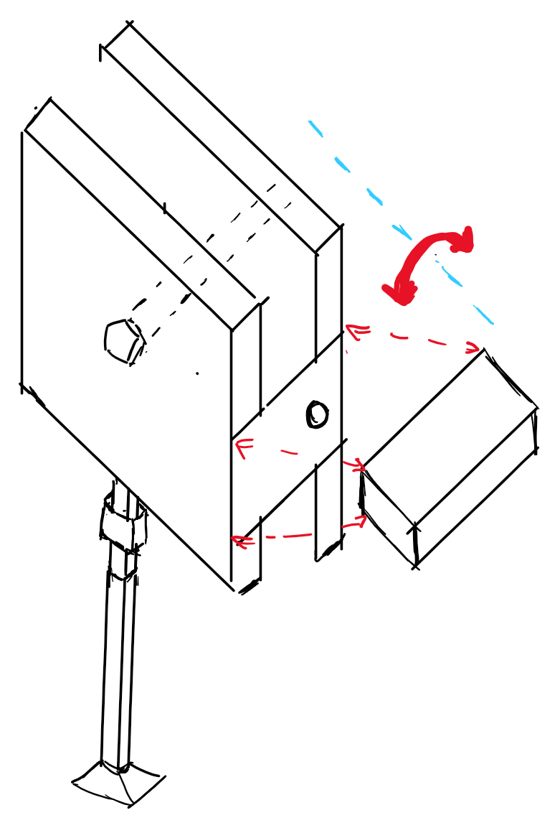
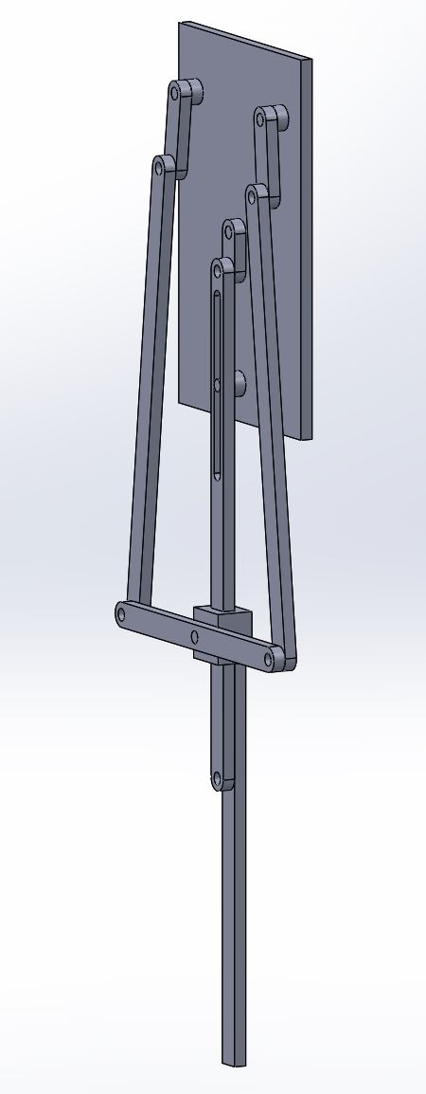
Choosing a Leg Design
Option 3: 4 motor Config.

Slide 11
4 Motor Clockwork
The dog’s leg will use four motors to provide three degrees of freedom
Two motors will provide variable linear motion along the leg
One will provide an angular rocker movement
A servo will allow rotation about the dog’s metal frame
Weight is supported by metal pin in double shear and by central link

Slide 12
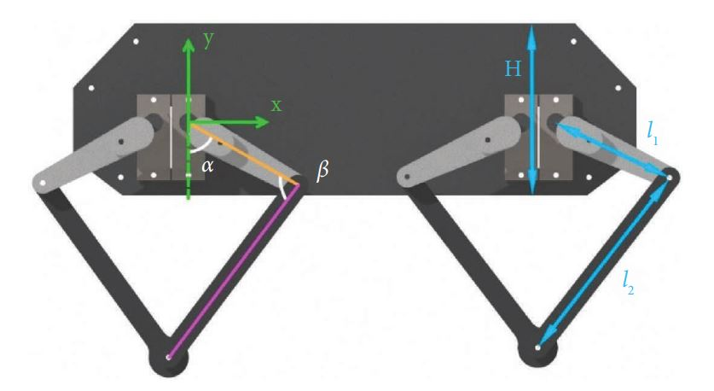
Choosing a Leg Design
Option 4: Linkage

Slide 13
Linkage
Two servo motors are used next to each other at the shoulder area
A two-linkage system is attached to each motor with both ends of systems connecting to a form a foot
A third servo will allow rotation about the dog’s metal frame

Slide 14
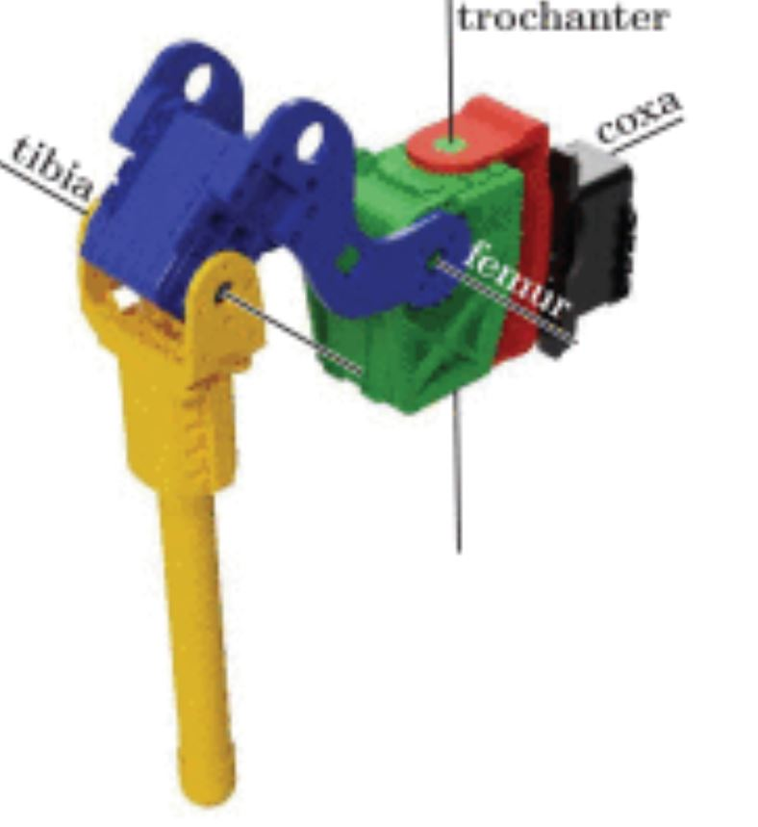
Choosing a Leg Design
Option 5: Hexapod

Slide 15
Hexapod
Leg uses four servo motors, but it can be simplified to a three-servo system
Each servo motor at different location down the leg starting from “shoulder”
Legs are not in line with body’s frame and point outward
Adding fourth servo facilitates keeping center of mass lower than three servo configuration

Slide 16
Choosing a Leg Design
Option 1
Option 5
Option 4
Option 3
Option 2
Requirement | 3 servo | Hexapod | Linkage | rpm driven gait | Mini Pupper
3 DOF | Uses servos for three axial DOF | 4 servos configuration | 3 servos all near shoulder | 3 motors and possibly 1 servo | 3 servo motor all located at shoulder
Support on 2 Legs | Can use worm gears to prevent backdrive and gears to ratio torque increase | Worm gears and gear ratios | gear ratios | strong material and metal pin | worm gear and gear ratios, may also use spring as tensile support
Stability | Rubber padding/stoppers | low center of mass | linkage made from stiff material | linkage made from stiff material | Rubber padding/stoppers

Slide 17
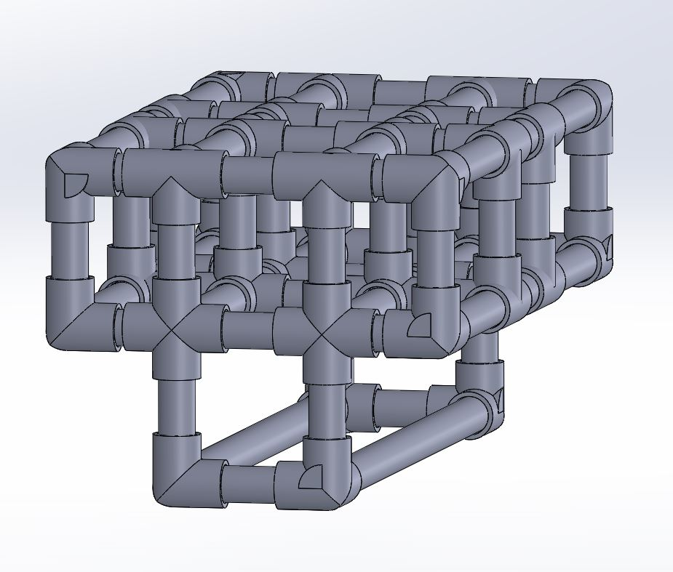
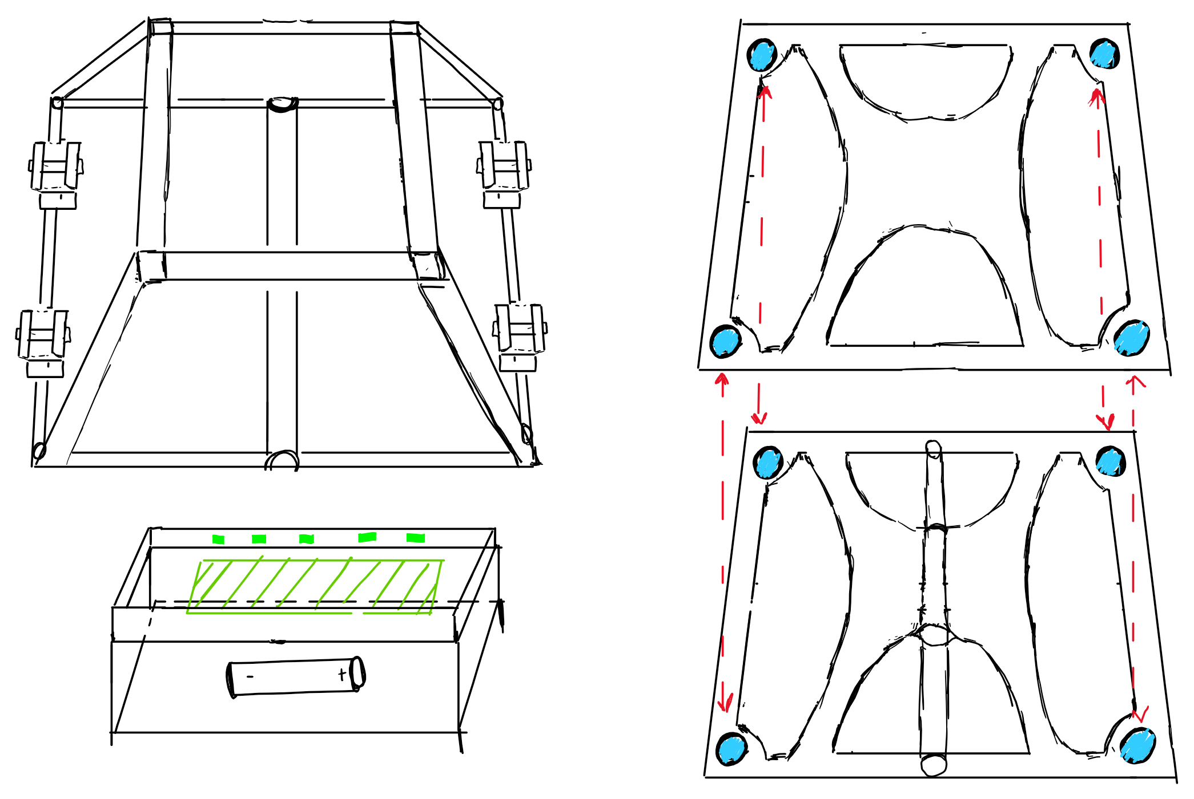








Body Casing
Requirement: Body’s casing will be light

Slide 18
Body Casing
Thin clear plastic/acrylic will be used as walls for a trapezoidal body
Plastic/acrylic will be used for front and back faces
Metal rods will act as the frame and “spine” of the dog
Removable pod/container can be used to easily access components

Slide 19
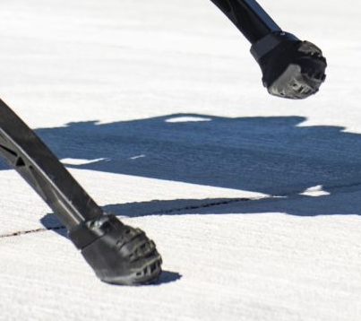
Traction
Requirement: Dog must not lose traction while on tile floors or carpet

Slide 20
Traction
Most of the dog’s movement will be on flat tile surfaces, carpets and possibly flat concrete
Its possible that the legs can slide on smooth surfaces while it moves and may lower the overall speed
Rubber or plastic with similar properties will be used for the base of each foot

Slide 21
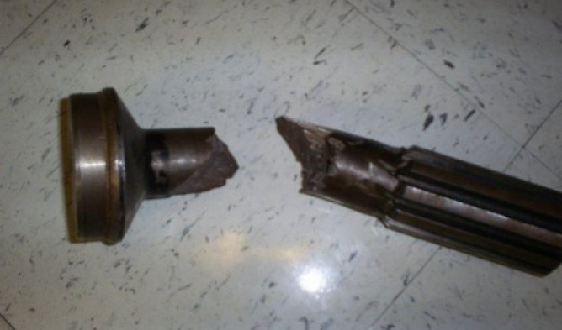
Testing for Failure
Requirement: Limbs must resist failure under load

Slide 22
Testing for Failure
Testing for where each part will likely fail under load will help inform us as to what points require more support
When a weak point is identified, a higher density of material can be used instead of its previous design
This allows for the weak point to withstand the forces acting on it

Slide 23

Object Detection
Requirement: Reach from point A to point B while detecting obstacles

Slide 24

Avoiding Obstacles
Use LiDAR sensor to scan local (short distance) area to identify and verify objects
The use of RGB camera and ultrasonic sensor will detect the best current path to avoid obstacles
Determine if color accuracy vs latency will affect result of the camera
Going from point A to point B with minimum or no collision

Slide 25

Understanding Obstacles
Identifying an object color depth will help the dog to maneuver
LiDAR sensor to detect 3D objects in a limited range
A potential use of infrared or ultrasonic sensor may be used to map vertical plane objects (wall)

Slide 26
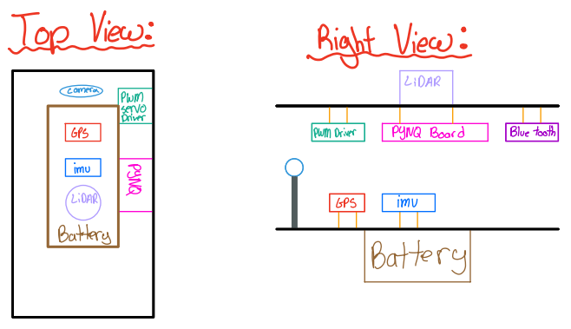
Sensors
Requirement: Sensor Status and Location

Slide 27
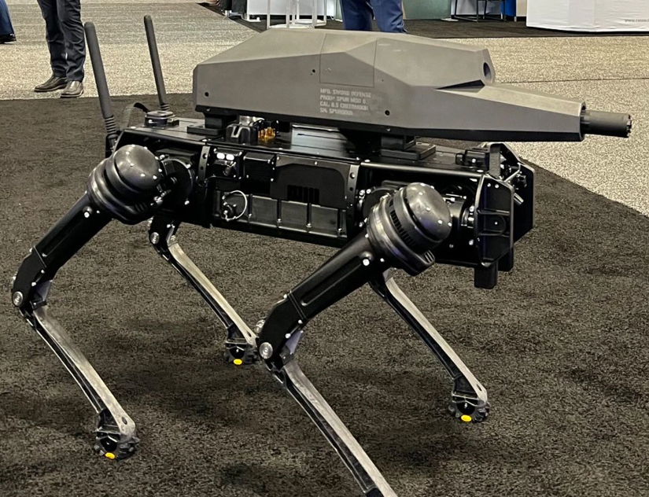
Updating Status
Robotic Dog will have a dedicated system to follow the host using Bluetooth beacon
Concept is to use the host cellular device to connect and get the final updated destination
May add an embedded storage to store dog direction that could be used to improve "best route"

Slide 28
Following Host
Robotic Dog will have a dedicated system to follow the host using Bluetooth beacon
Concept is to use the host cellular device to connect
Update the host signal to the dog continuously

Slide 29
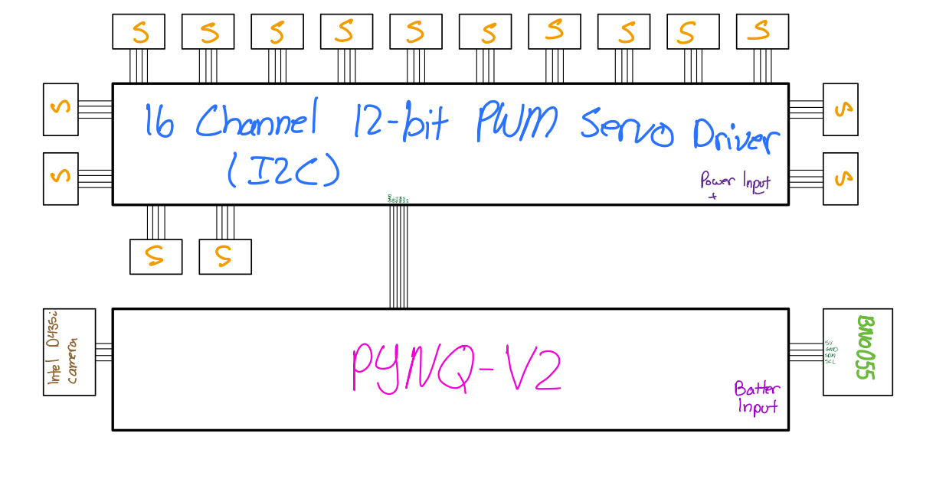
Power Consumption
Requirement: Dog must maintain battery life of 30 minutes of use

Slide 30
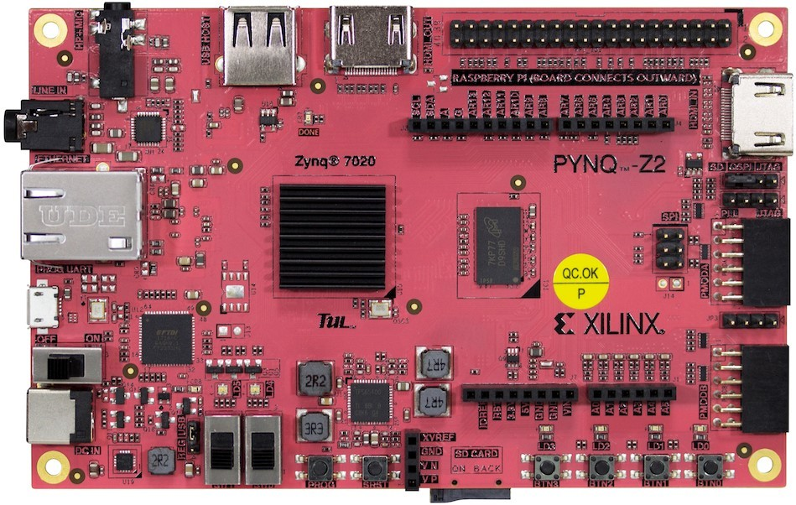
Microprocessor
The brain of the dog that will control all the sensors, microcontrollers, and servos
Specifications:
Voltage Input: 7V – 15V
Total Power: P=IV=(12V)(3A)=36W

Slide 31
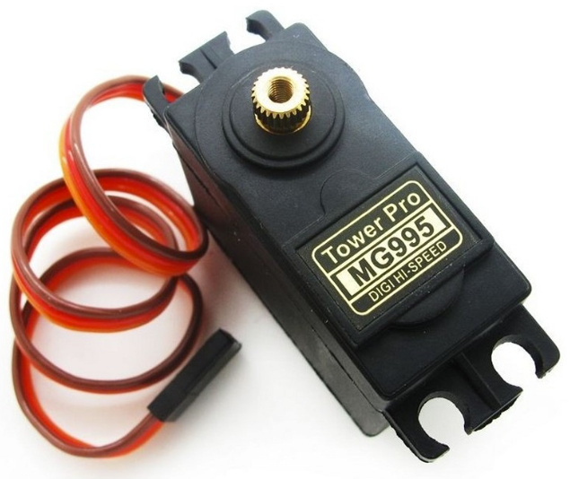
Servo's (MG995)
Potential servo that may be use but may change in the future are the MG995
Specification:
Operating Voltage: 4.8V - 6V
Stall Current: 1500mA
Power: P=IV=(1.5A)(6V)=9W
Note, 16 servo's may be used:
16 * 1.5A = 24A for just servo's

Slide 32
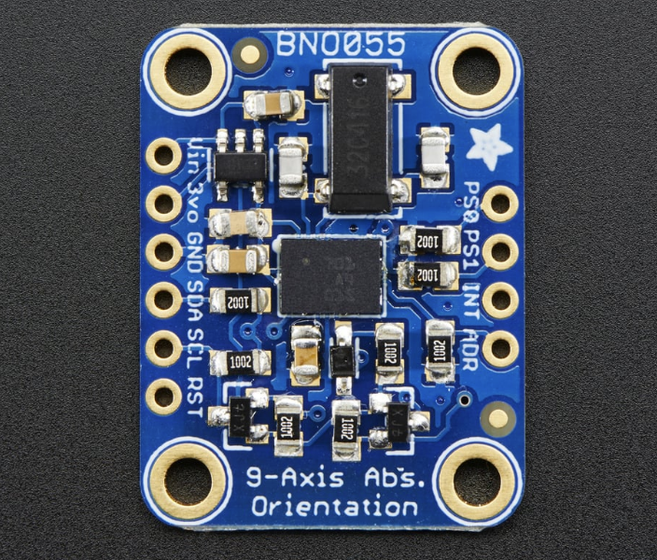
Absolute Orientation Sensor
Need to create a 3D space to level the dog and maintain stability
Specification:
Voltage Input: 2.4V - 3.6V
Total Supply Current (@ 3V): 12.3mA
Low Power Current: 0.4mA
Suspend Mode: 0.04mA
Power: P=IV=(0.123A)(3V)=0.369W

Slide 33
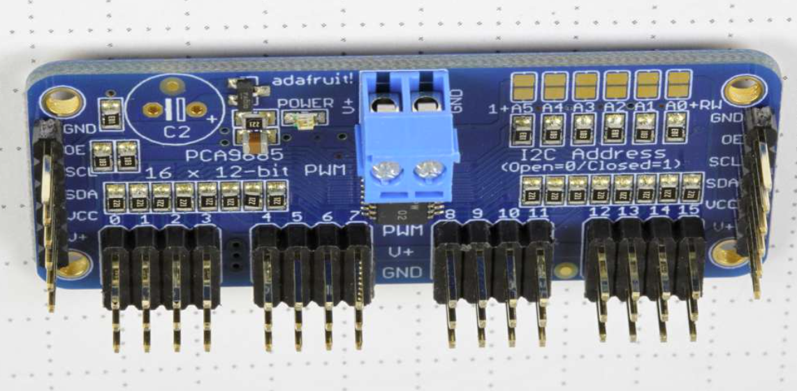
16 Channel Servo Driver
Will help reduce and simplify controlling the Servo's
Needs an external power source
Specification:
Voltage Input: 3V - 5V
Max Current per Channel: 25mA
Decoupling capacitance is more probable when 16 channels are in use

Slide 34
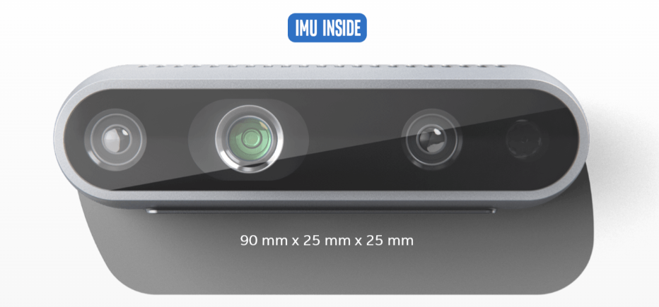
Intel D435i
NOTE: We may or may not use the camera
Contains two imagers (right and left), color sensor, and IR Projector
The camera uses two modes for the camera
USB 2.0: Restricted of how much resolution and refresh rates that can be sent back
USB 3.1: Able to use full bandwidth for camera and potential features

Slide 35
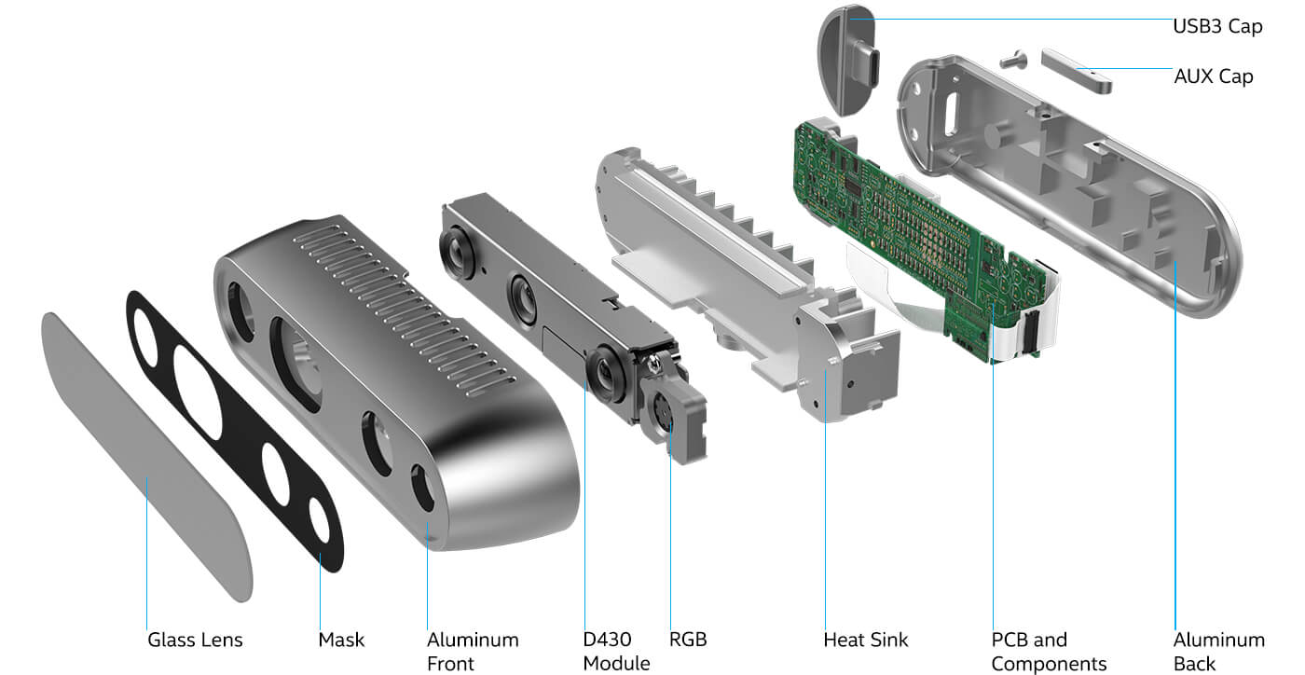
Intel D435i (part II)
Specification:
Voltage Input: 5.25V
Max Current: 700mA
Power: P=IV=(0.7A)(5.25)=3.675W
USB 3.1 allows full access of bandwidth not related to power (so far from datasheet)

Slide 36
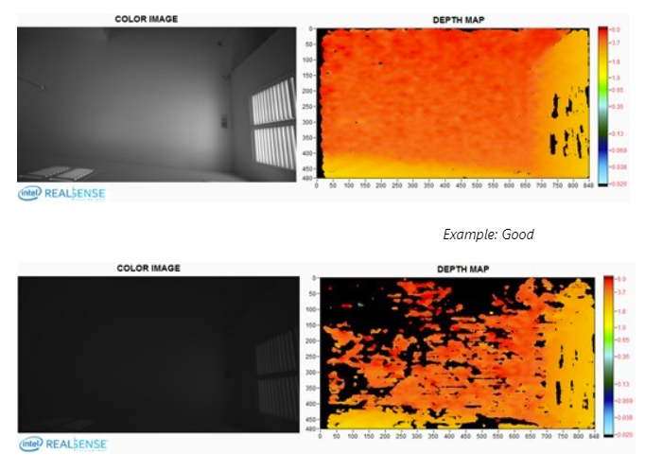
Intel D435i (part III)
Cons:
Intel states the depth camera will degrade dramatically in sunlight
Link
Stereo depth needs to be calibrated and needs a reference structure to validate data

Slide 37
Intel D435i (part IV)
Pros:
Gives 10-bit Raw data
Vertical Field of View: 100.6°
Horizontal Field of View: 65.5°
Focal Length: 1.93 mm

Slide 38

Overall electrical Ingress Protection
Ingress Protection (IP) refers to the rating of the protection of the components. First number refers to solid obstacles and second number refers to liquid solution
Microprocessor, microcontroller, and drivers must be rated at IP65 to avoid accidental spills

Slide 39
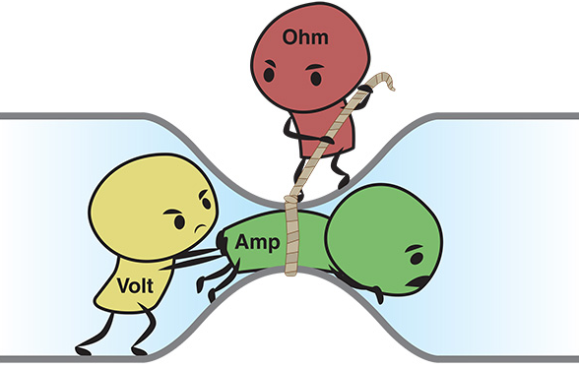
Battery
Prototype dog will be supplied through by a power supply
Final production will use a LiPo Battery
Due to high Amperage

